Slide 1
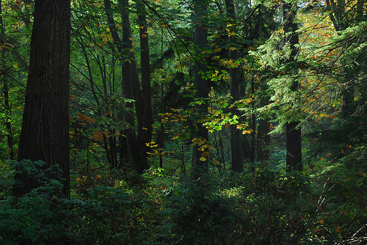
Dimensions of a Learning Network
Stephen Downes
National Research Council Canada
October 6, 2010

Slide 2
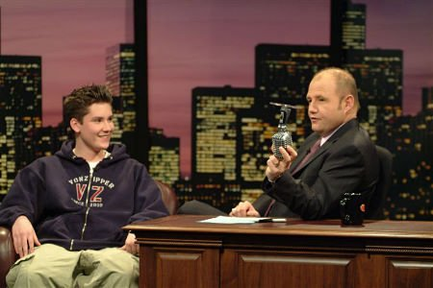
The humour is in the listener
Find something you have in common
Bring them around to your point of view
Make them laugh at themselves
Erin McKean
Image: http://www.imdb.com/media/rm3822688768/tt0161180
http://halfanhour.blogspot.com/2010/09/uniqueness-and-conformity.html

Slide 3
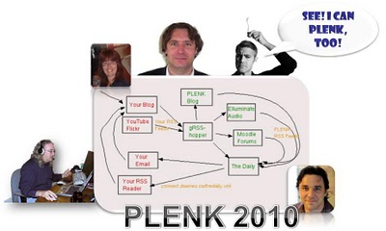
Learning Networks, or
Networks that Learn
Today’s Topic
Constraints and Conditions

Slide 4
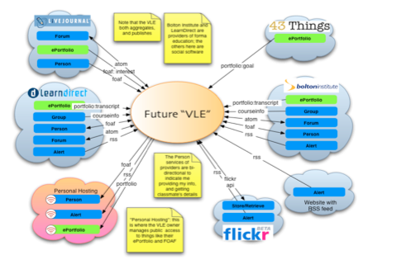
The Personal Learning Environment
Using networks to learn…
Image: http://www.cetis.ac.uk/members/ple/resources/edf.ppt
http://ple.elg.ca/

Slide 5
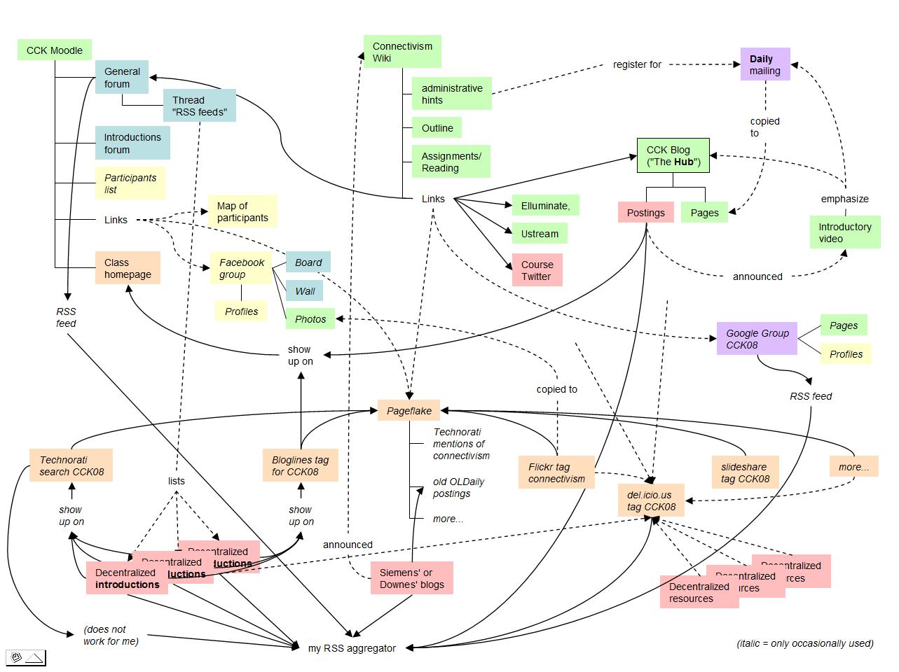
#PLENK2010
An instantiation of these constraints
A distributed learning environment
The MOOC
http://connect.downes.ca/

Slide 6
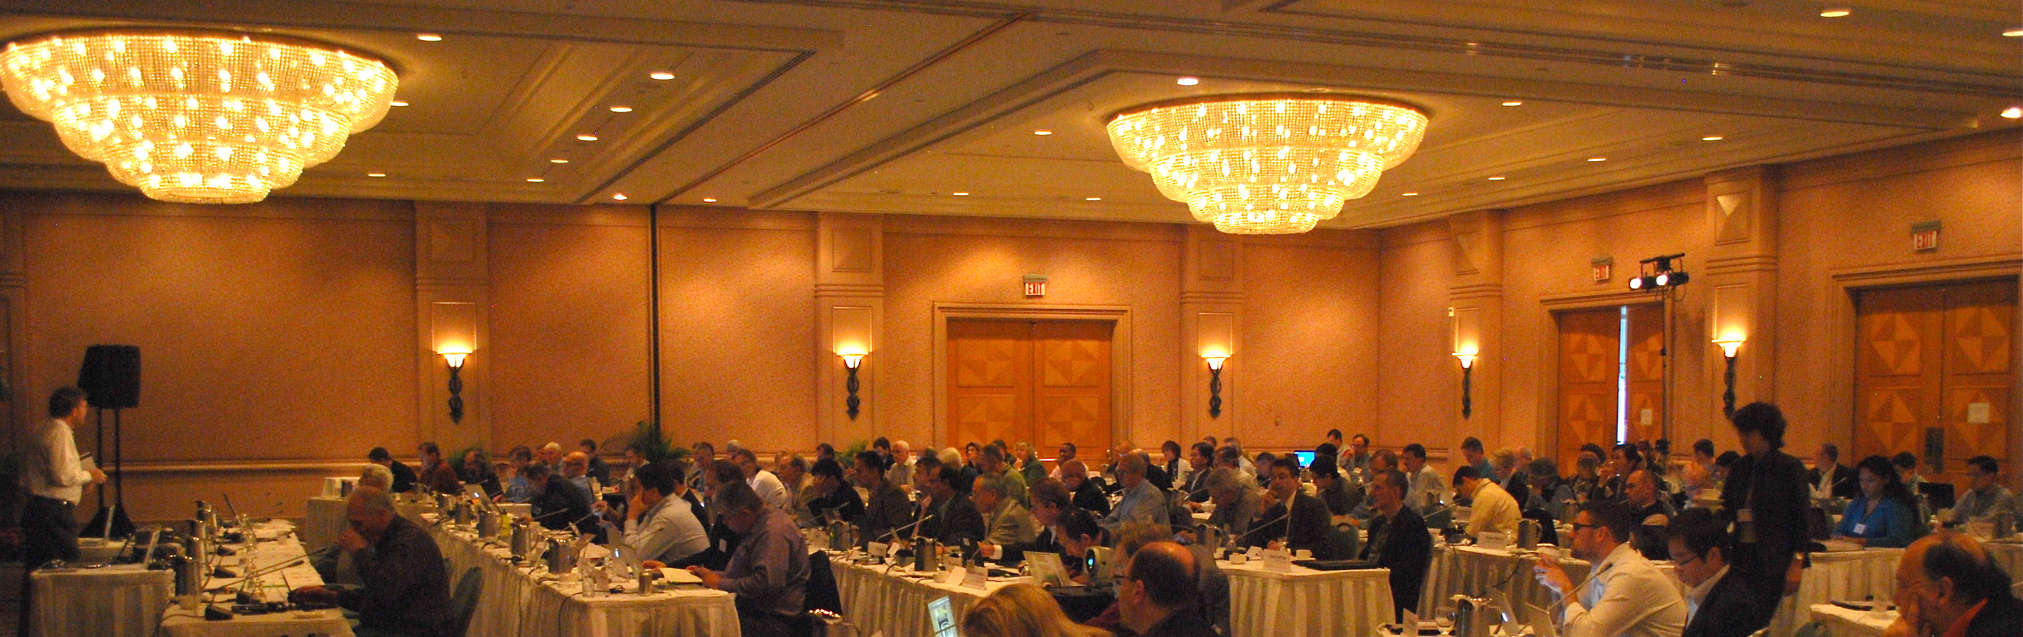
Yesterday
Attempting to understand using yesterday’s values…
Power, trust, incentive, propagation, broadcast, messaging
What we saw were surface phenomena
That’s why we saw so many maps

Slide 7
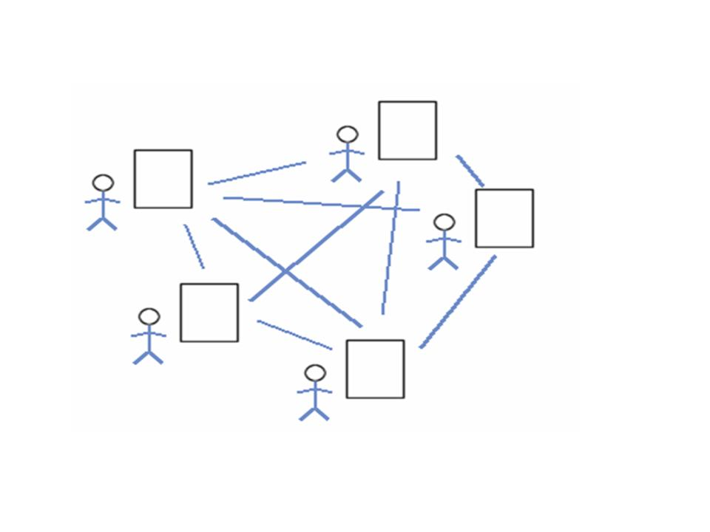
Collective Connective Intelligence
David Reed: the power of peer is in the peer
Is the power of the brain in the neuron?
Really?
http://www.downes.ca/post/43456

Slide 8
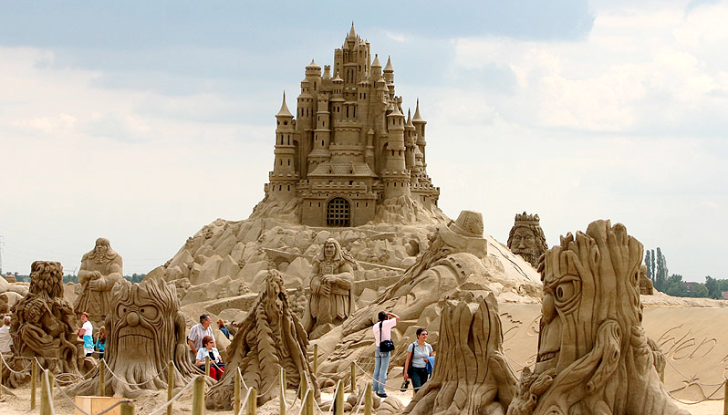
Organization
We’re trying to understand society by collecting individuals
But a sand castle isn’t just a pile of sand
Image: http://pixdaus.com/single.php?id=25529
http://www.downes.ca/presentation/257

Slide 9
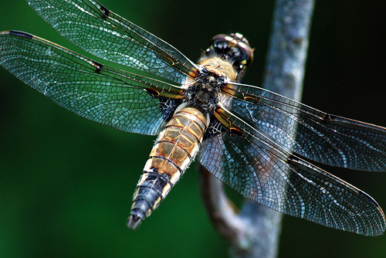
Connectivism
Knowledge is distributed across a network of connections
Learning is the ability to traverse and grow those networks
http://www.downes.ca/post/38653

Slide 10

Engagement and Empowerment
There is no curriculum, no body of knowledge
The product of learning is the learner
Fernando Flores
Emotional Fortitude
21st century skills
Image: http://www.masternewmedia.org/news/2008/06/01/making_sense_of_new_technologies.htm
http://www.downes.ca/post/51122

Slide 11
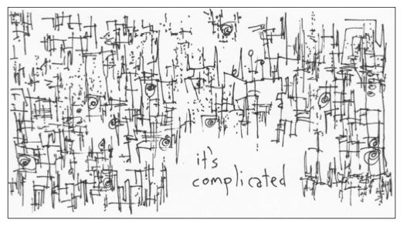
Complexity
It’s not that there’s nothing to learn
But that it’s complex, and needs to be navigated
Not memorized
Image: http://www.gapingvoid.com/complicated128.jpg
http://www.downes.ca/post/48669

Slide 12

gRSShopper
A tool for learning networks
It functions as a node
Not as part of a mass
http://grsshopper.downes.ca/

Slide 13
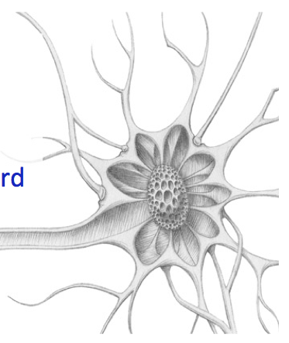

Learning is Immersive
We function as nodes in the network
Aggregate, remix, repurpose, feed forward
Newmark: listen to people, repeat what they say, and then get out of the way.
http://ple.elg.ca/course/?p=18

Slide 14
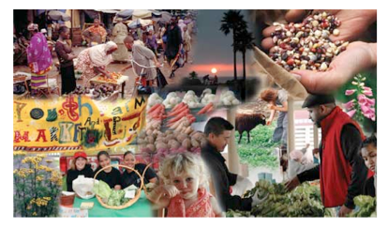
Learning is growth
We develop our neural net by participation in the social net
That’s also how we develop the social net
http://www.downes.ca/post/53527

Slide 15
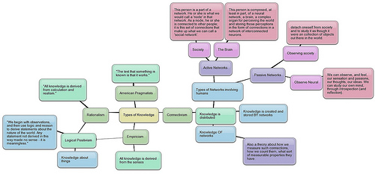
Networks, Network Theory
Two kinds of knowledge
Networks in general
A common set of principles
Image: http://techticker.net/2008/09/16/types-of-knowledge/
http://www.downes.ca/post/33034

Slide 16
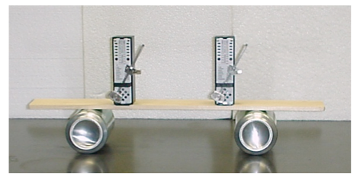
Metronomes
Self Organization
http://salt.uaa.alaska.edu/dept/metro.html
http://www.youtube.com/watch?v=W1TMZASCR‐I

Slide 17
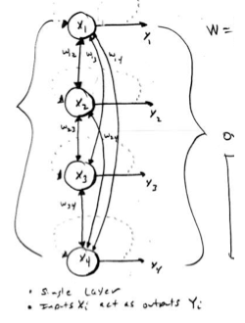
Principles of Association
How networks learn = how networks form connections
http://www.downes.ca/post/53544

Slide 18

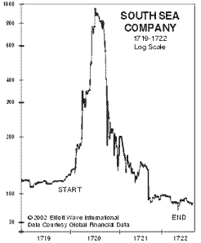
Cascade Phenomena
Quality of network learning =
Retained and expanded capacity to form connections
Cascade phenomena (diseases, propaganda) = network death
http://www.downes.ca/post/53882

Slide 19
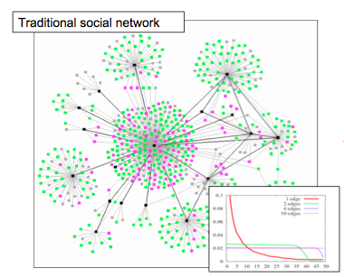
Network Structure - Tree
Centralized, based on influence, trust
Characterized by power law, viral propagation, hierarchy
http://middleburydemocrats.wordpress.com/2008/09/28/college‐democrats‐getting‐obama‐to‐go‐viral‐no‐really/

Slide 20
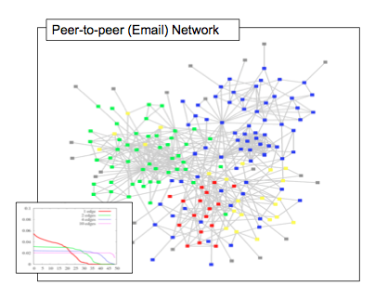
Network Structure - Mesh
Distributed, discussion based
Balanced, democratic
Stable
http://www.daniel‐lemire.com/fr/abstracts/DIVERSITY2008.html
blog/using‐email‐to‐uncover‐hidden‐social‐networks/

Slide 21
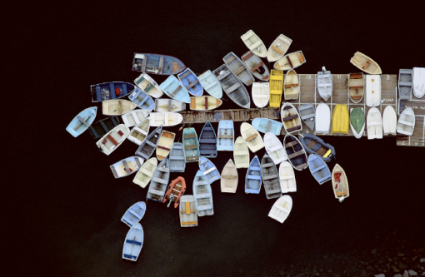
The Limits of Scale Free
When networks are not limited by physical constraints
They tend toward network death
Image: http://limitedfun.wordpress.com/category/photography/page/6/
http://www.downes.ca/post/48579

Slide 22
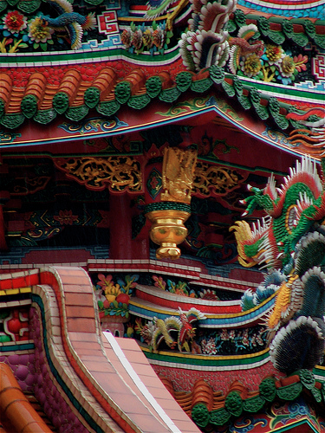
Stable (Self-Organizing) Networks
Decentralize
Distribute
Disintermediate
Disaggregate
Dis-integrate
Democratize
(The Semantic Principle)
Dynamize
Desegregate
http://www.downes.ca/presentation/32

Slide 23
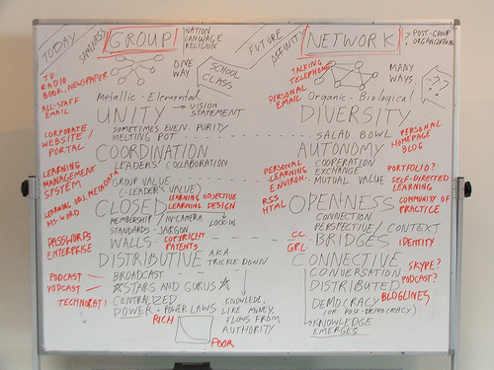
The Semantic Principle
Autonomy – individual values, not collective (or corporate) values
Diversity – each person has a distinct perspective
Openness – there are fluid boundaries, no ownership or walls
Interaction – the knowledge is the network, not in the individual
Fernando Flores
Pluralistic Networks
http://www.flickr.com/photos/stephen_downes/252157734/

Slide 24
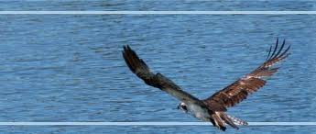
Your Business Takeaway
These values are not just abstract
They represent a shift in business values from ownership and control to stewardship, agility and stability
They should inform everything from management practices to software purchases
http://www.downes.ca/post/38502

Slide 25
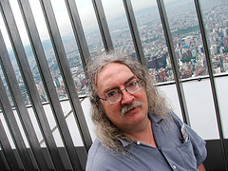
Stephen Downes
http://www.downes.ca

